Slide 1

Types of Distributed Operating Systems
Class Activity
Md. Dulal Hossain
ID: M260205002

Slide 2
Distributed Operating System
A Distributed Operating System (DOS) is an advanced system software layer that manages a collection of independent, networked, and physically separate computational nodes, making them appear to users as a single unified system.
Distributed Operating System (DOS)
Network Operating System (NOS)
Middleware

Slide 3
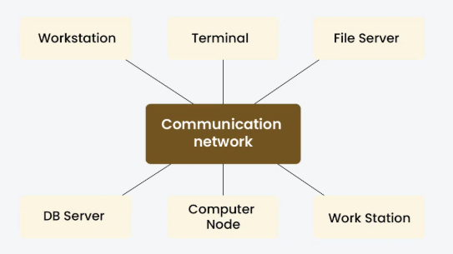
Distributed Operating System (DOS)
A Distributed Operating System (DOS) is used in tightly coupled systems, where multiple processors or computers are closely connected and usually have similar hardware.
Main Goal: To hide and manage hardware resources, so users feel they are using a single powerful computer instead of many computers.
Example: A supercomputer or a multi-processor server.

Slide 4
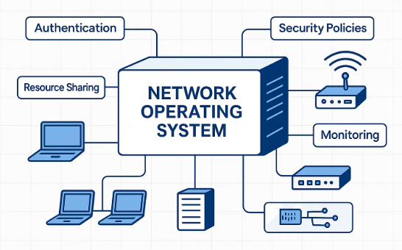
Network Operating System (NOS)
A Network Operating System (NOS) is designed for loosely coupled systems, where computers are connected through a LAN or WAN and may have different hardware or operating systems.
Each computer works independently but can share files, printers, and other resources over the network.
Main Goal: To offer local services to remote clients.
Example: Windows Server or Linux servers connected over a network.

Slide 5
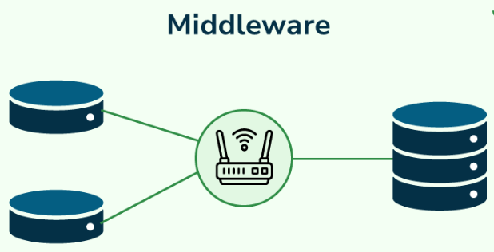
Middleware
Middleware is not an operating system itself. It is an additional software layer that runs on top of a Network Operating System.
It provides common services such as communication, security, data sharing, and synchronization between distributed applications.
Main Goal: To provide distribution transparency, meaning users do not need to know where data or services are actually located.
Example: Apache Kafka, CORBA, Java RMI, or cloud platforms.

Slide 6
Comparison
DOS: Appears as one single system and manages hardware resources.
NOS: Connects independent computers and allows them to share services.
Middleware: Makes distributed systems easy to use by hiding the complexity of communication.

Slide 7
Conclusion
DOS focuses on resource management.
NOS focuses on network resource sharing.
Middleware focuses on transparency and communication, making distributed applications and cloud computing more efficient.

Slide 8
Thank you. Any questions?

